Slide 1
Bus Booking System
RLL Project Team - 7

Slide 2
RLL Project Team – 7
Employee ID | Team Members
2563842 | Durgappagari Vaishnavi
2564489 | Jyothi S Ragate
2563116 | Kotharu Ch Siva Satya Venkata Sai Krishna
2563446 | P Benovin
2563923 | Raghupathi Priyanka
2563214 | Sujas Gupta
2563040 | Agalya M

Slide 3
Table of contents
01
02
03
Introduction
Description
Modules
04
05
06
Screenshots
Testing
Conclusion

Slide 4

Introduction
The Online Bus Booking System is a system that manages the bus company booking and ticketing processes
Admin can manage the application
Users can book tickets to their desired location
And the end goal of the project is to create a rich and user-friendly application for the same.

Slide 5
Scope
The Scope of our project is as follows User should be able to:
Login and browse schedules
Find a schedule to desired location
Admin should be able to:
Manage locations, buses, schedules
Update payment status of passenger

Slide 6

Technologies Used
Back End | Front End
Spring Data JPA | Angular 16
JDK 1.8 | Type Script
Spring Boot | Bootstrap
MySQL Database

Slide 7
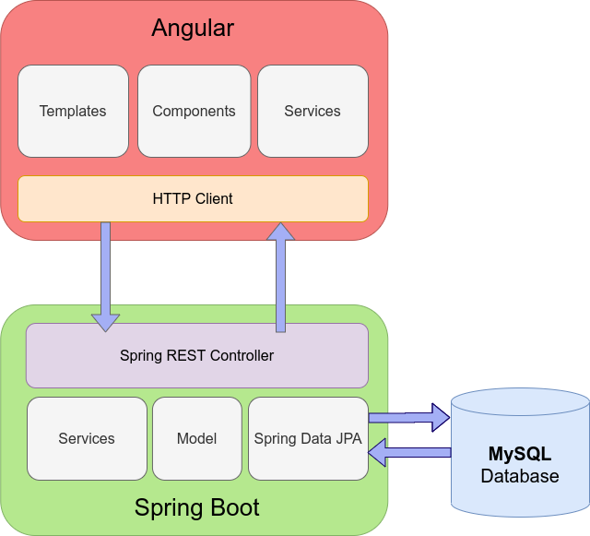
Block Diagram

Slide 8
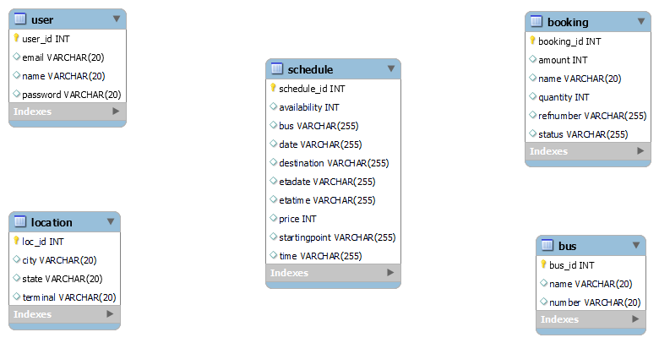
Entites

Slide 9
Modules
User
Bus
Location
Login, Register Admin can manage
Admin can manage
Admin can manage
Booking
Schedule
Find Schedule
Admin can update status User can book
Admin can manage Viewed by user
User can find desired schedule

Slide 10
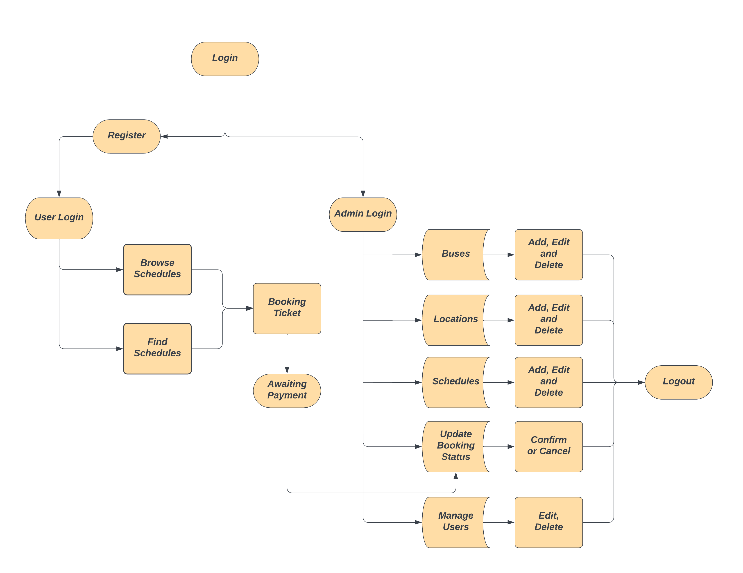
Process

Slide 11
01
User Module:

Slide 12
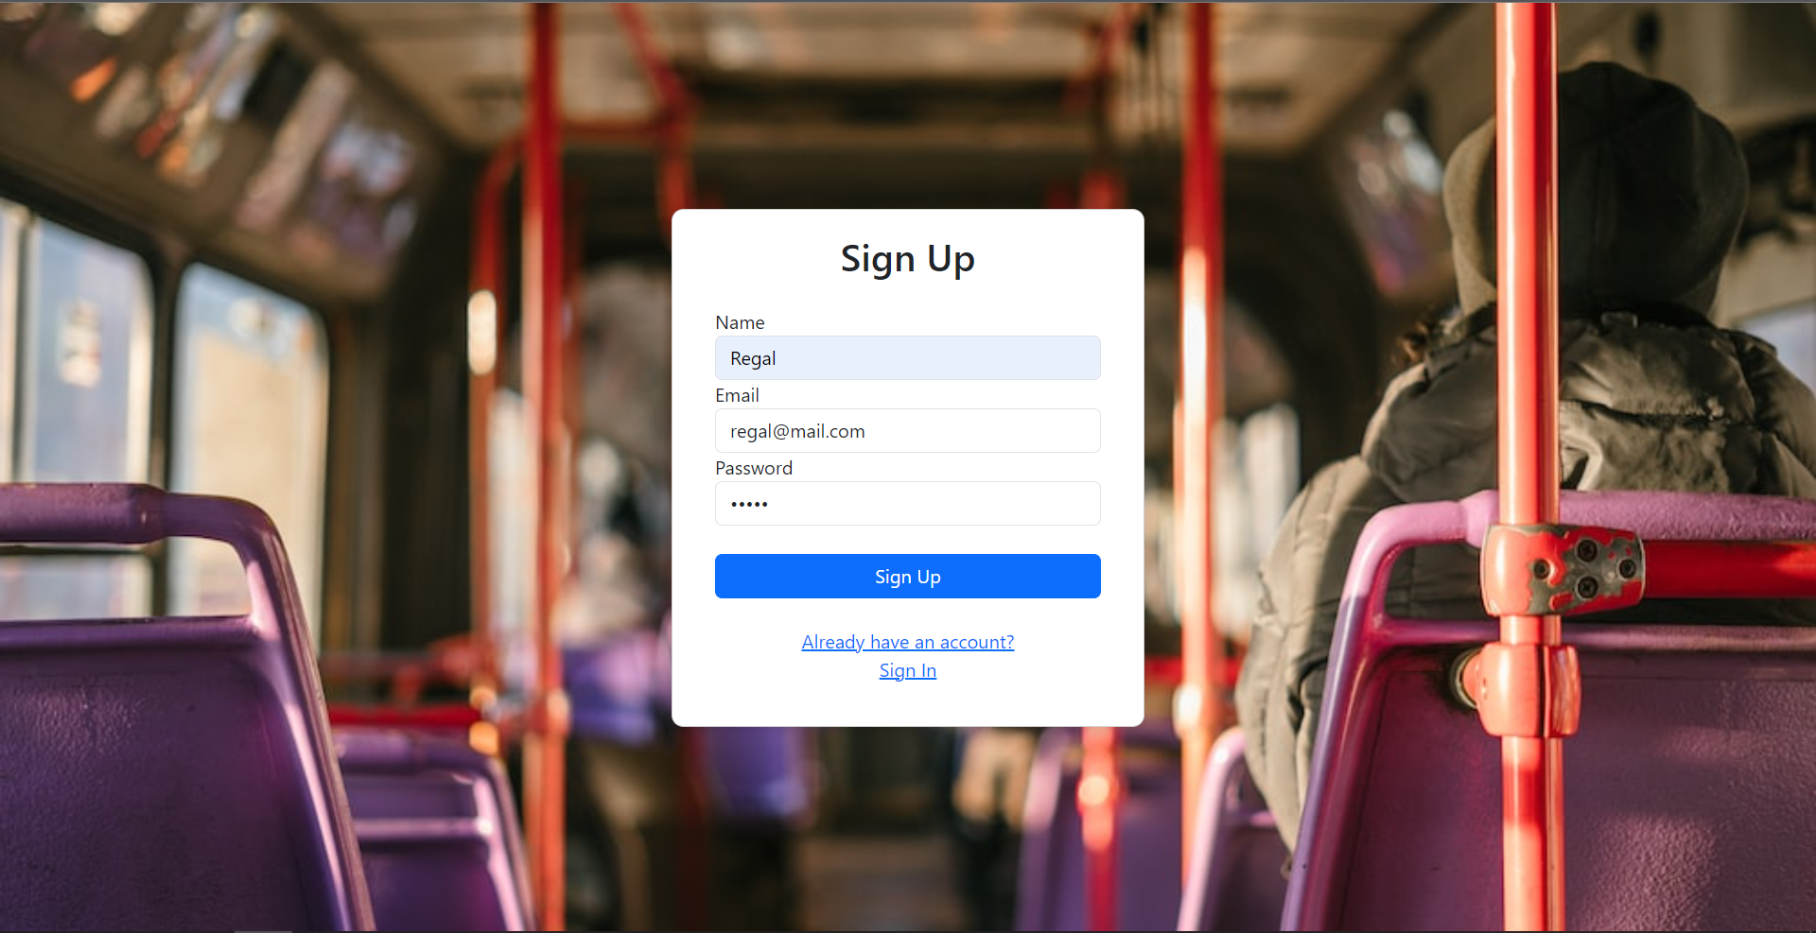
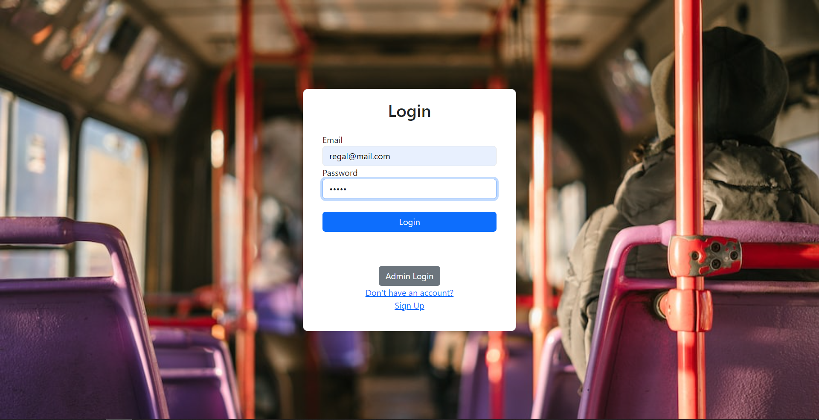
Login and Register Page

Slide 13
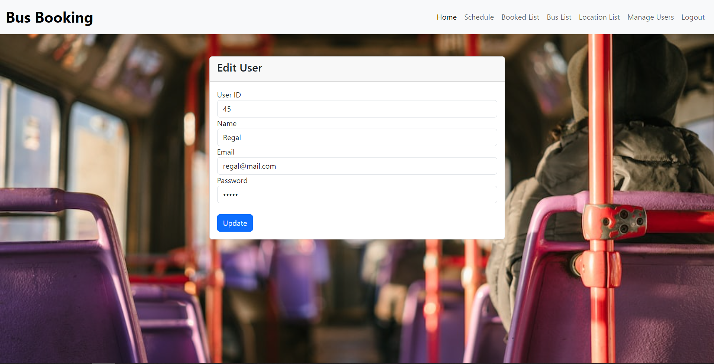
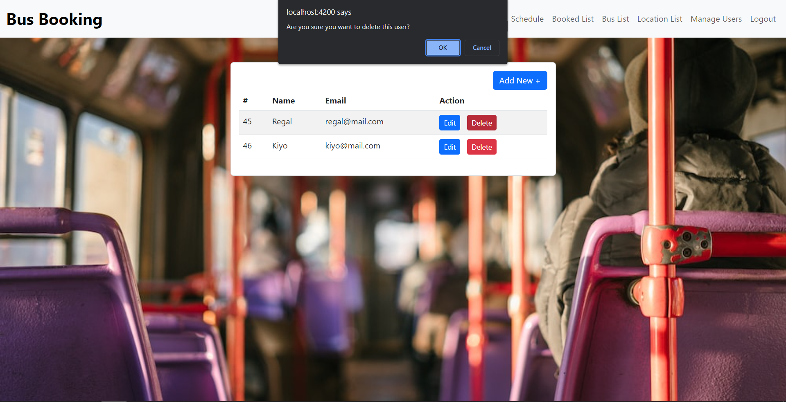
Editing and Deleting

Slide 14
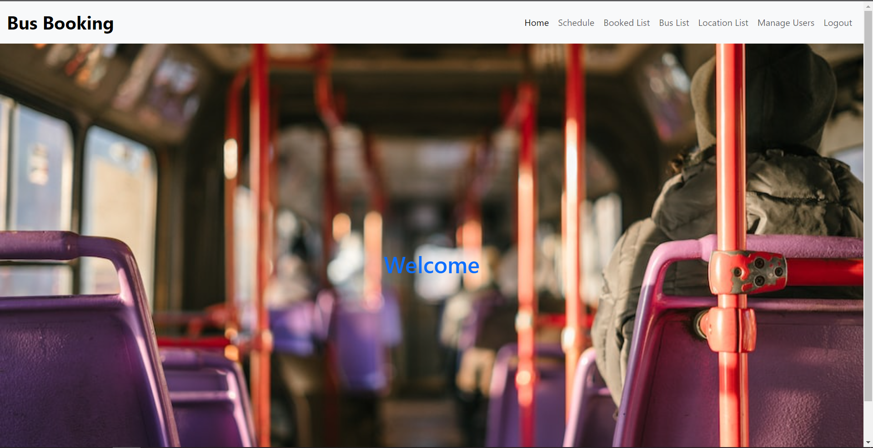
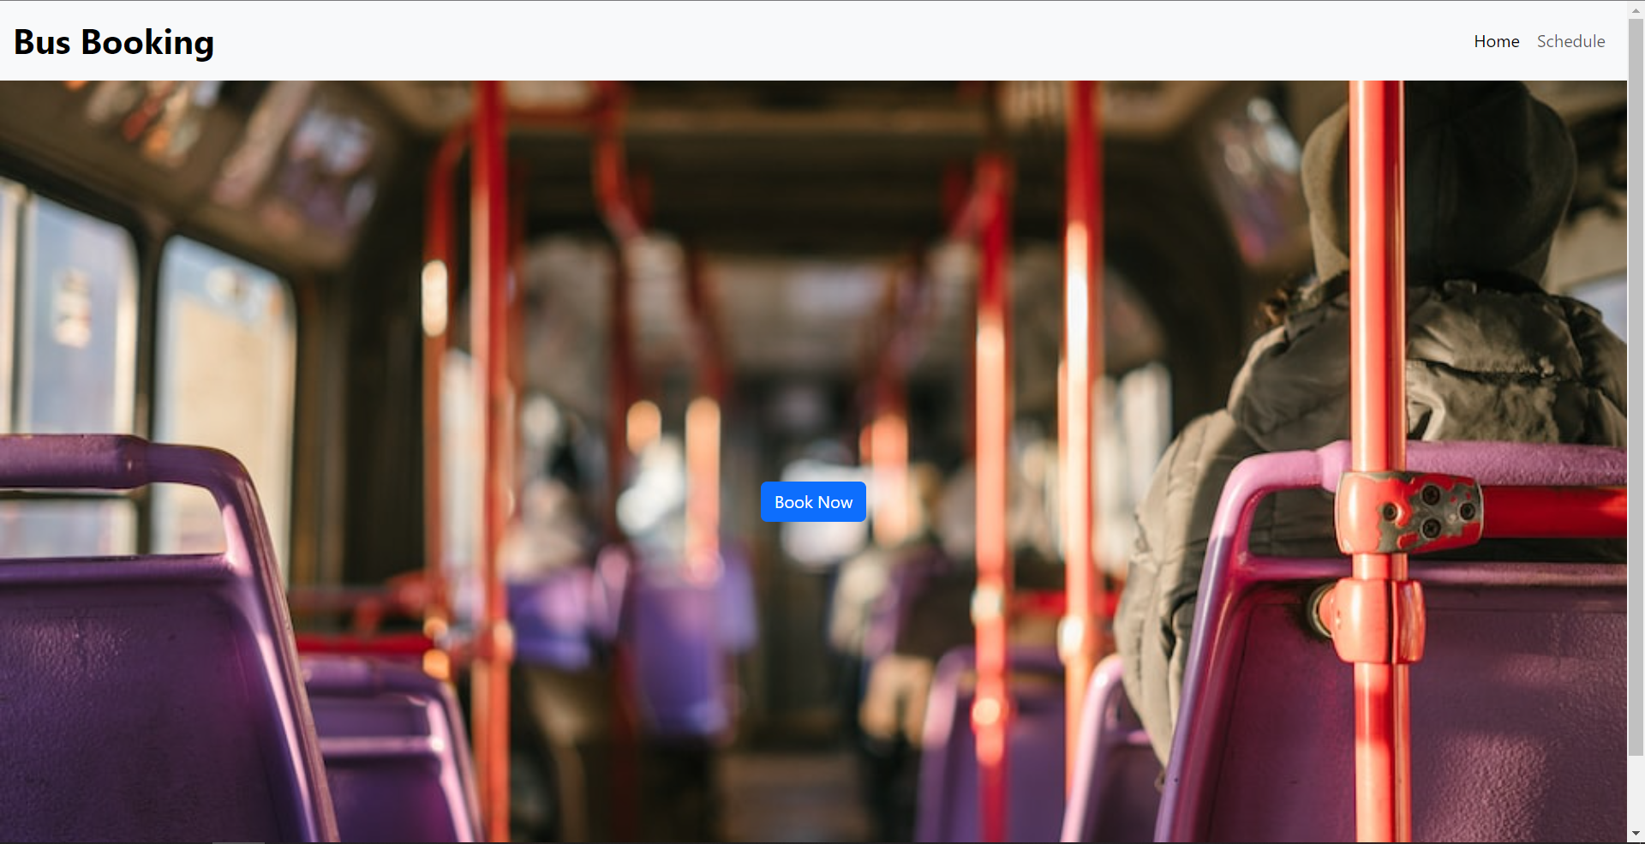
Admin and User Home Pages

Slide 15
02
Bus List Module:

Slide 16
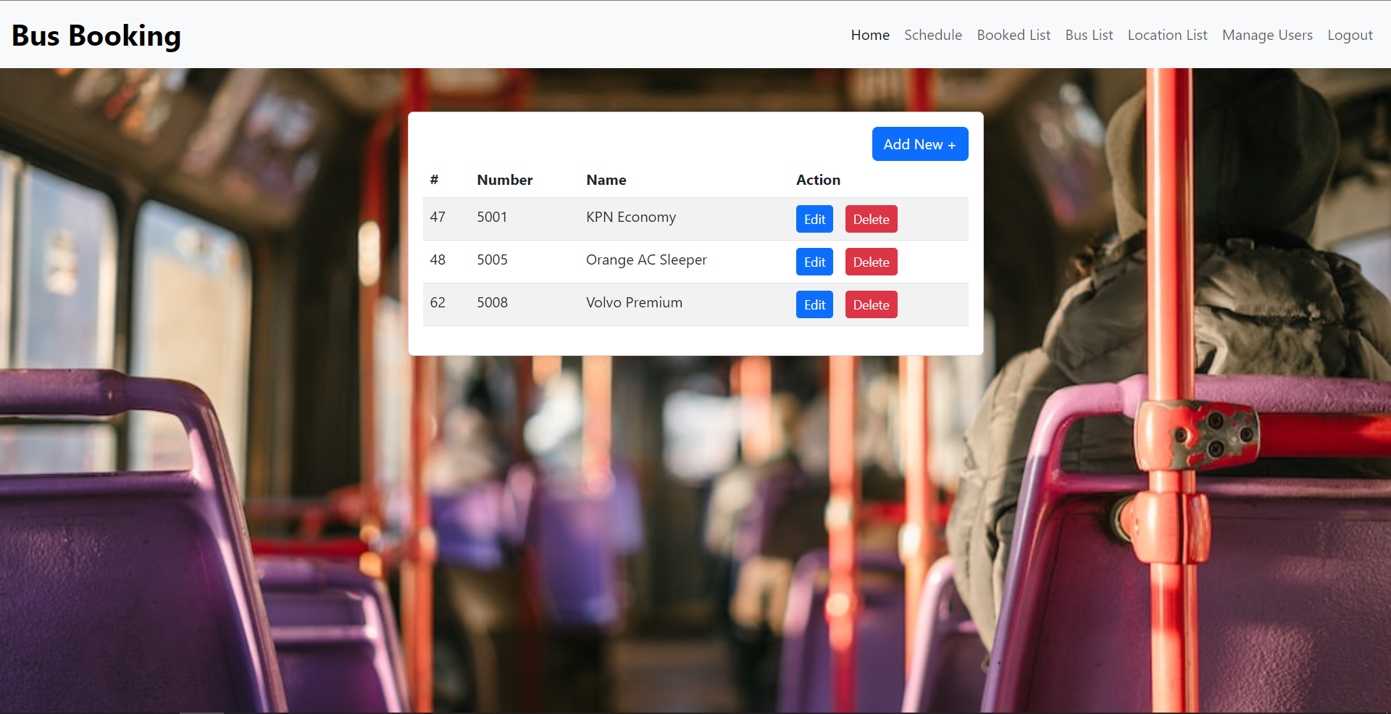
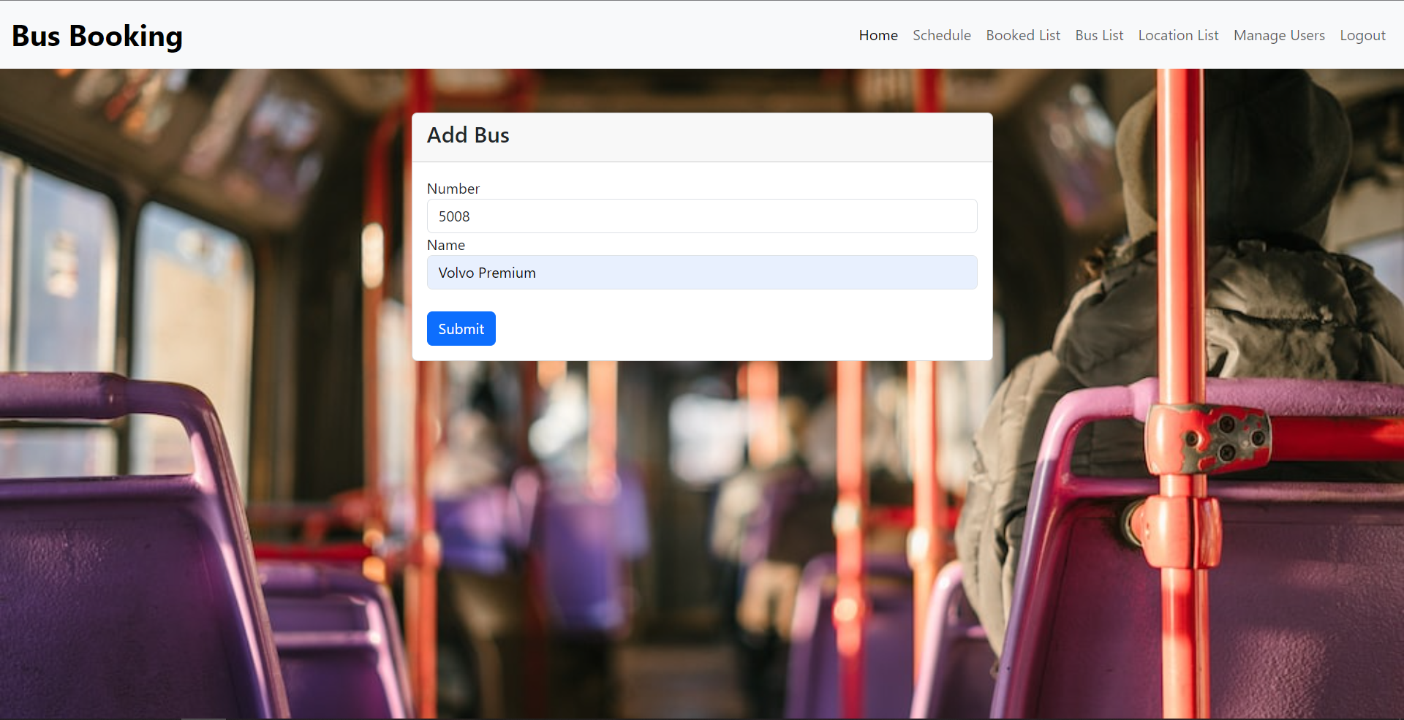
Bus list and New Bus

Slide 17
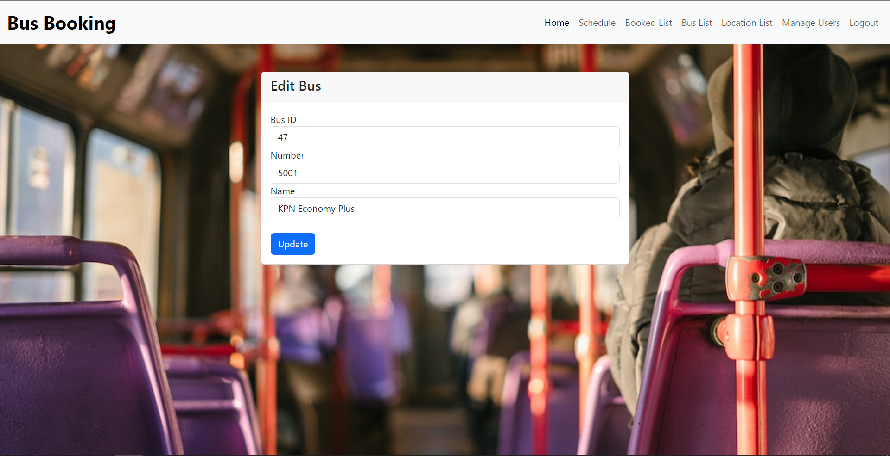
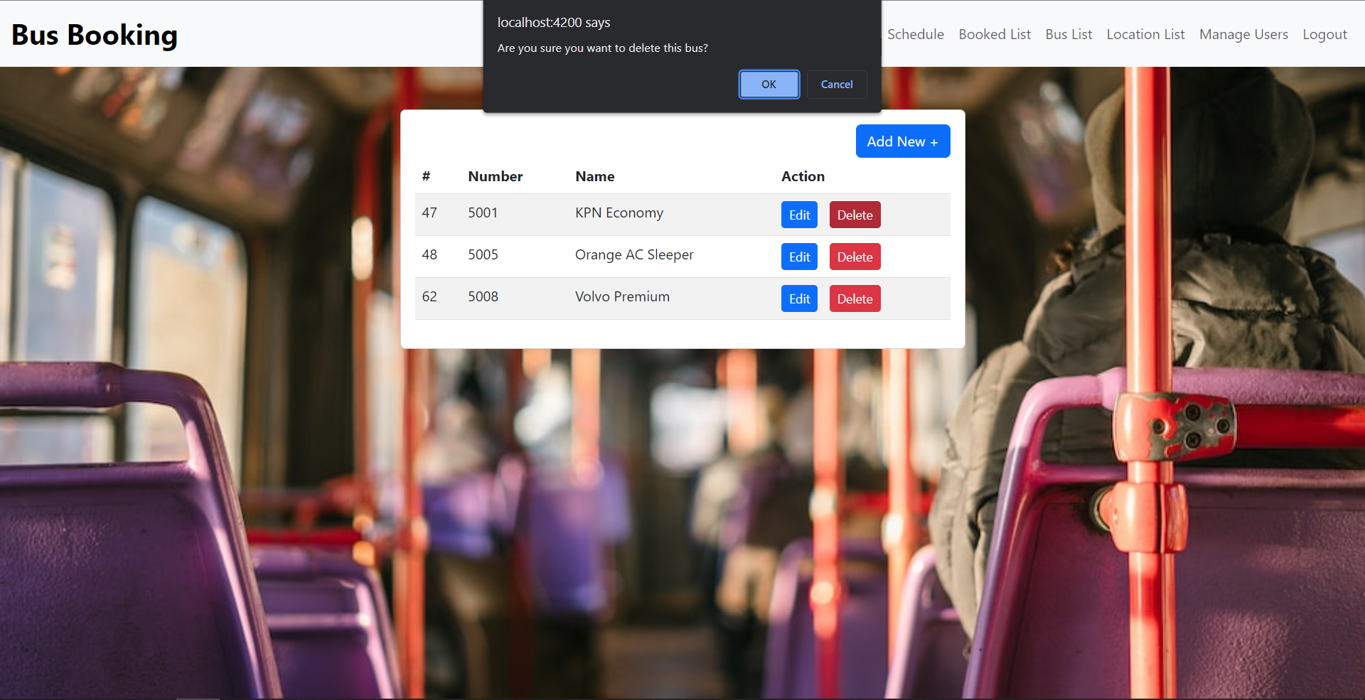
Editing and Deleting

Slide 18
03
Locations Module:

Slide 19
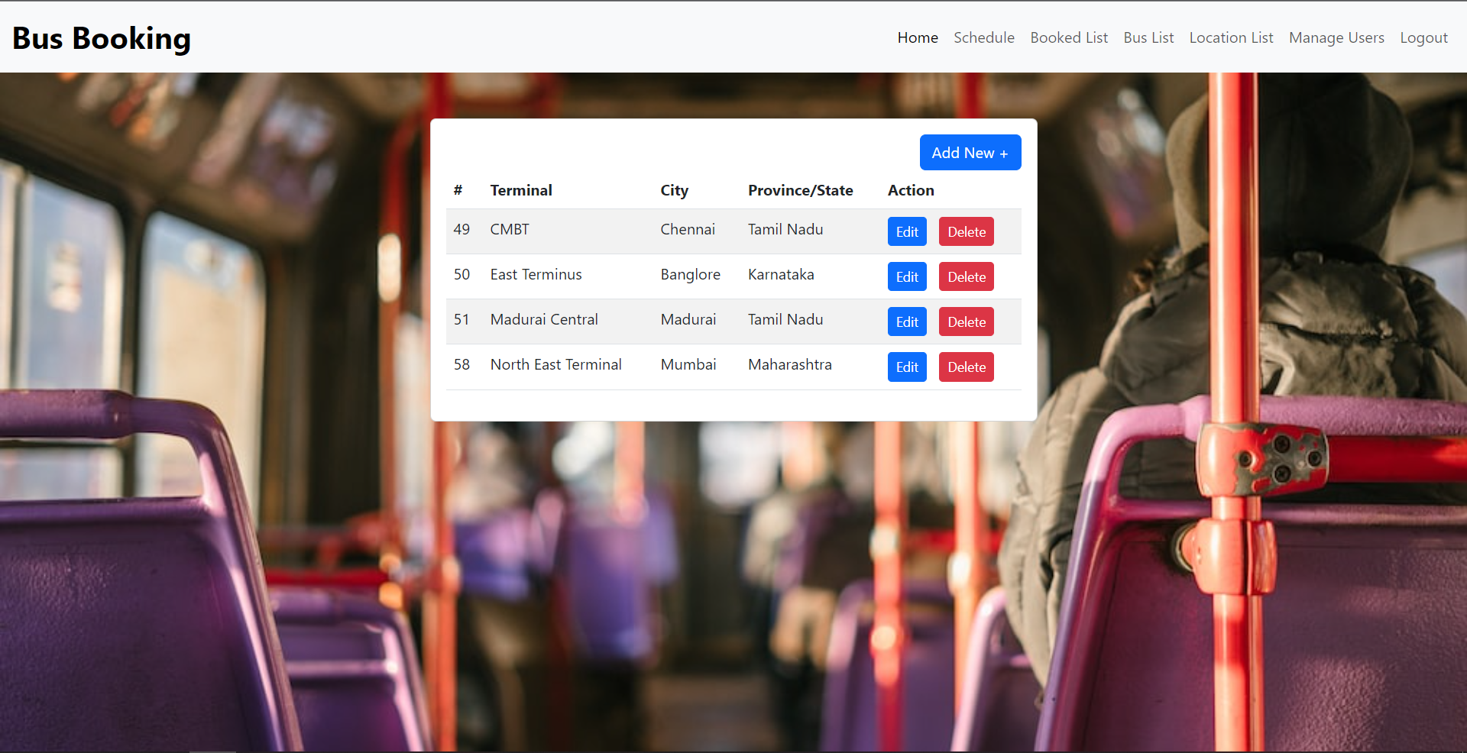
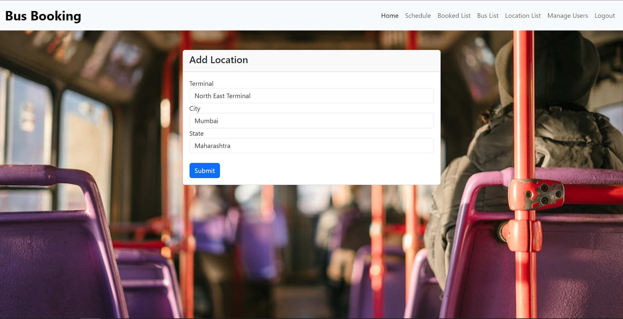
Locations and New Location

Slide 20

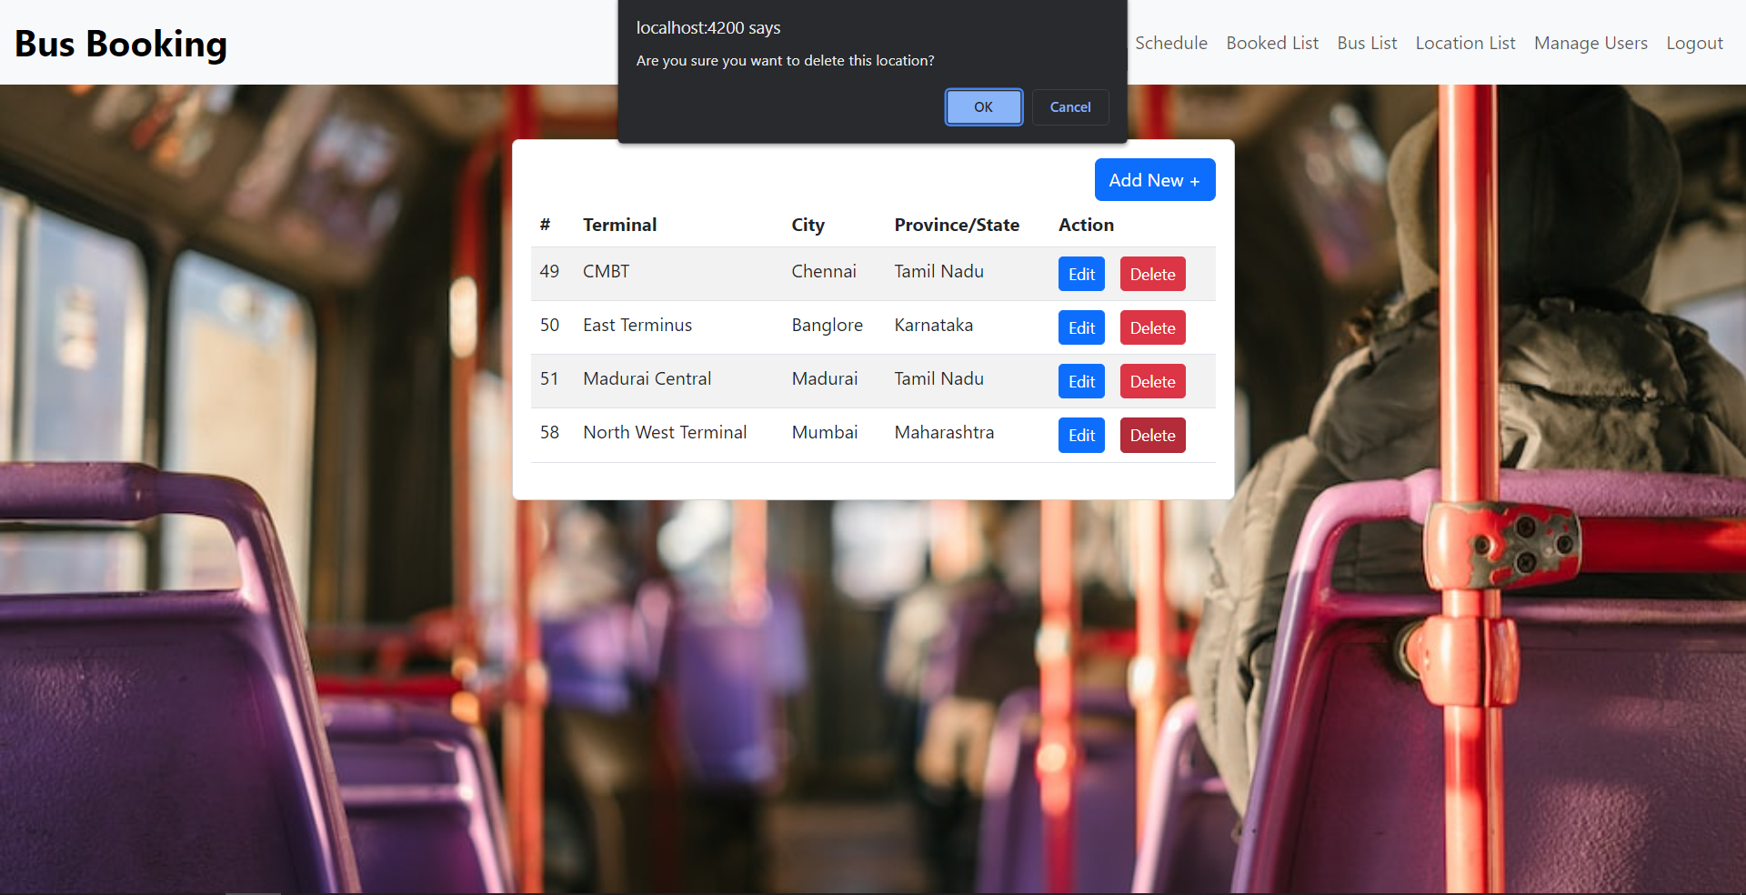
Editing and Deleting

Slide 21
04
Schedule Module:

Slide 22
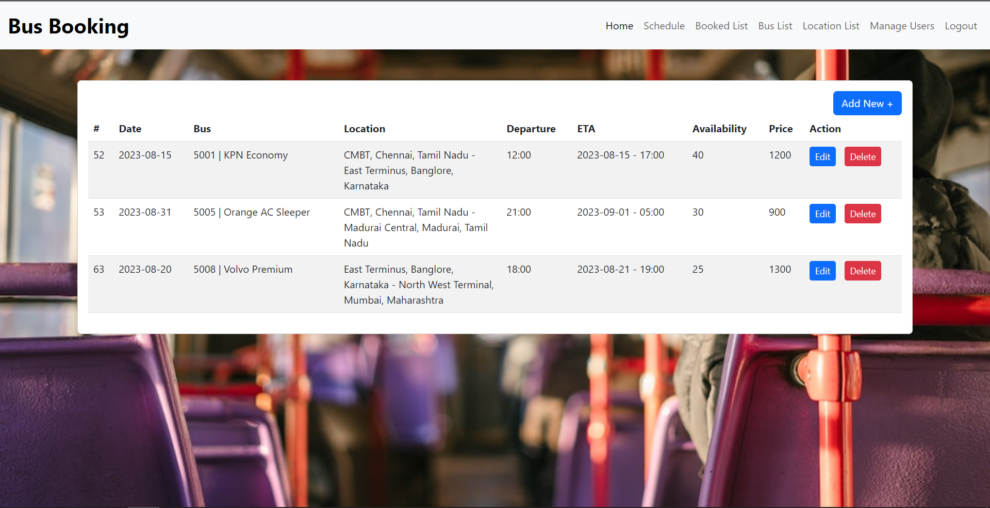
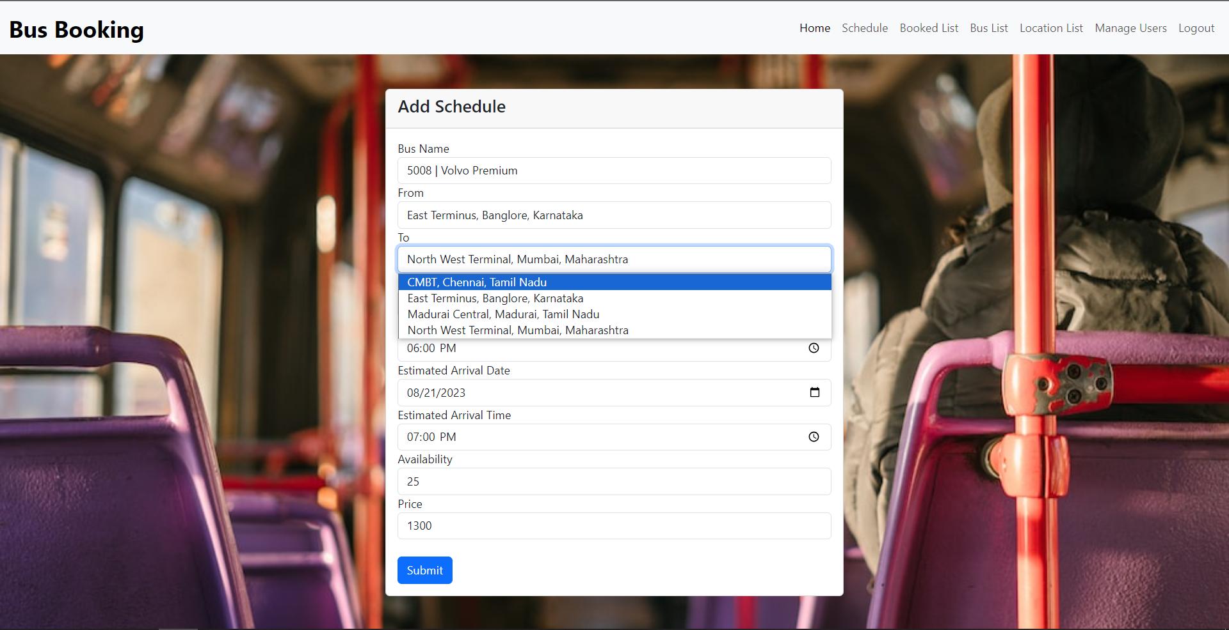
Schedules and New Schedule

Slide 23
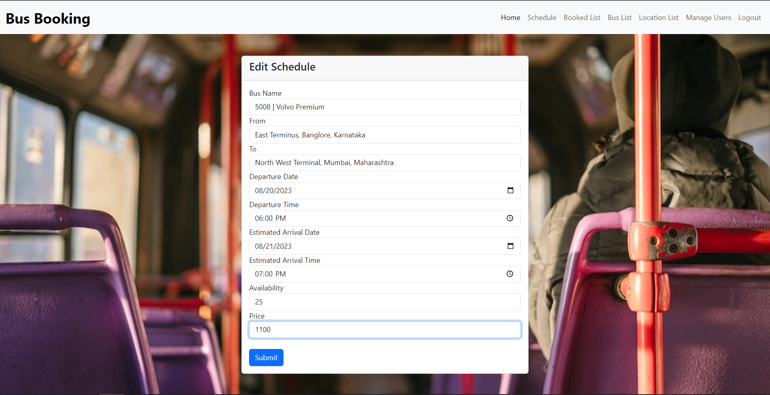
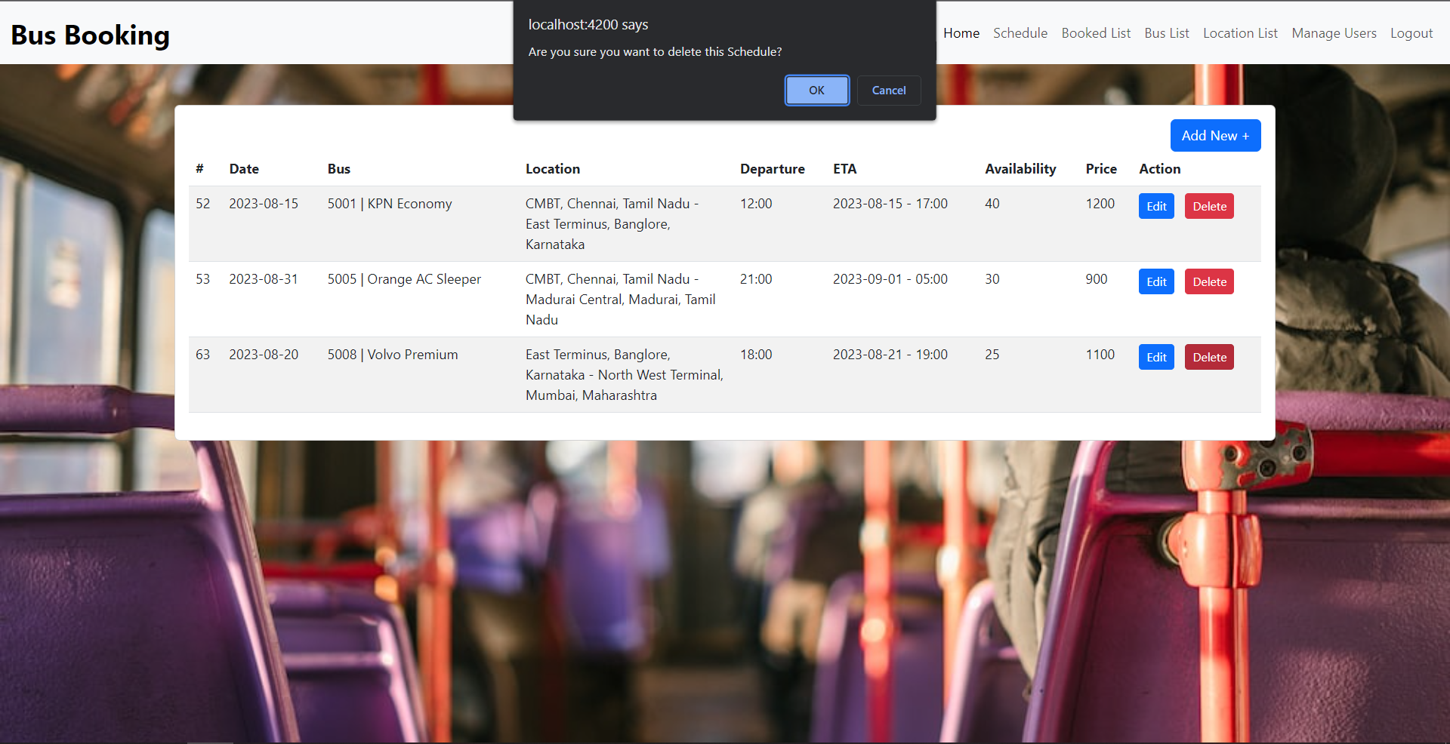
Editing and Deleting

Slide 24
05
Booking Module

Slide 25
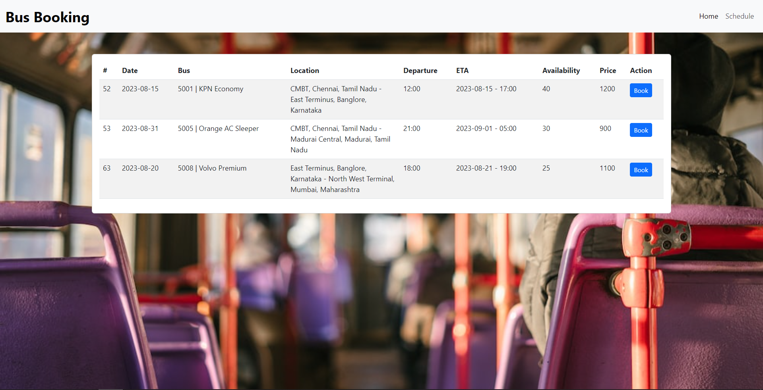
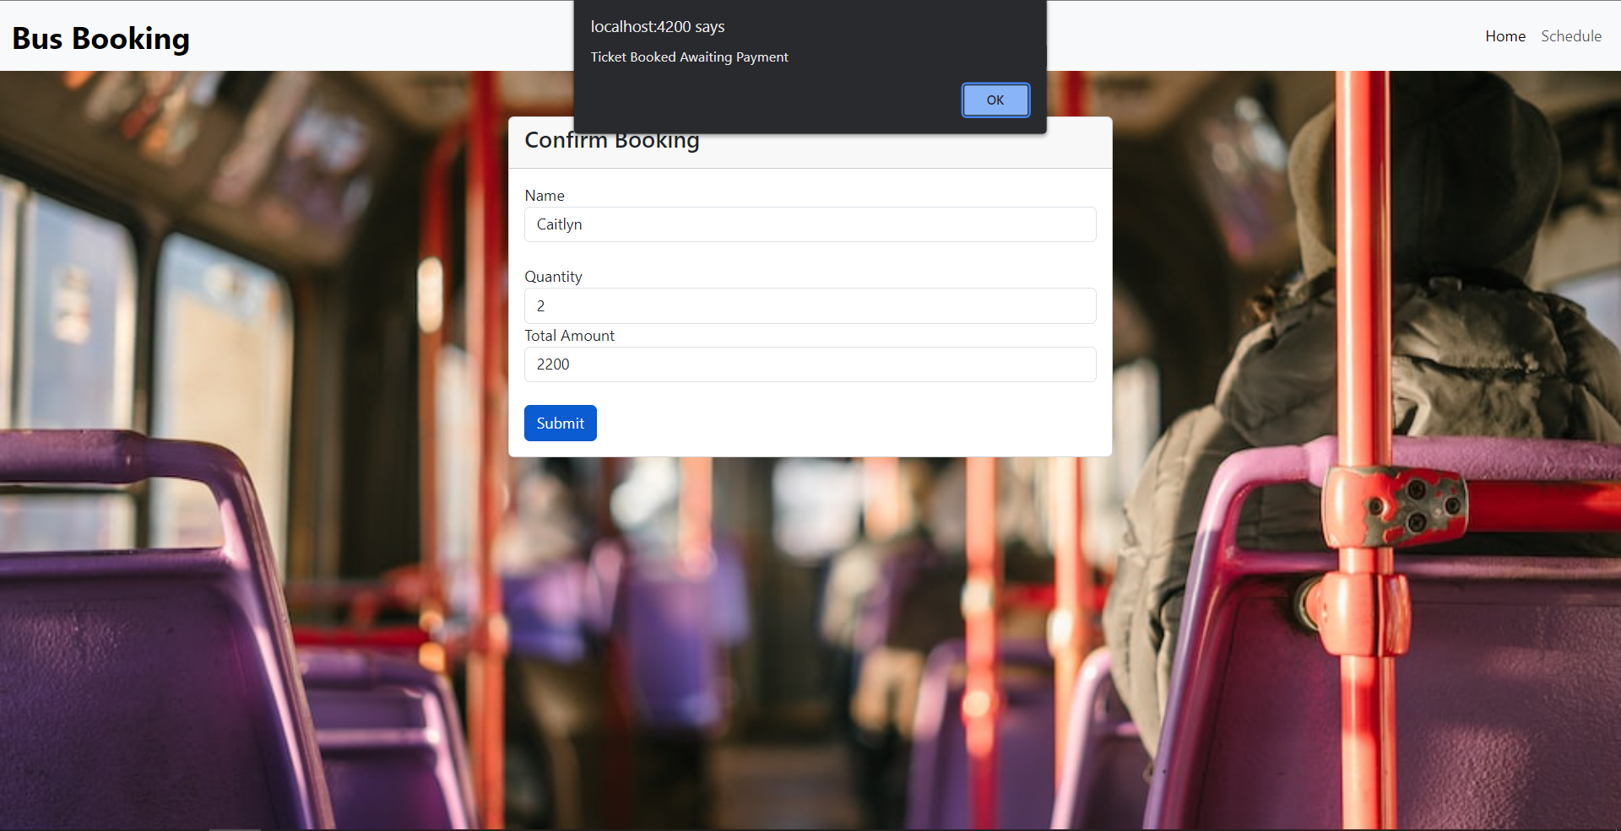
Booking

Slide 26
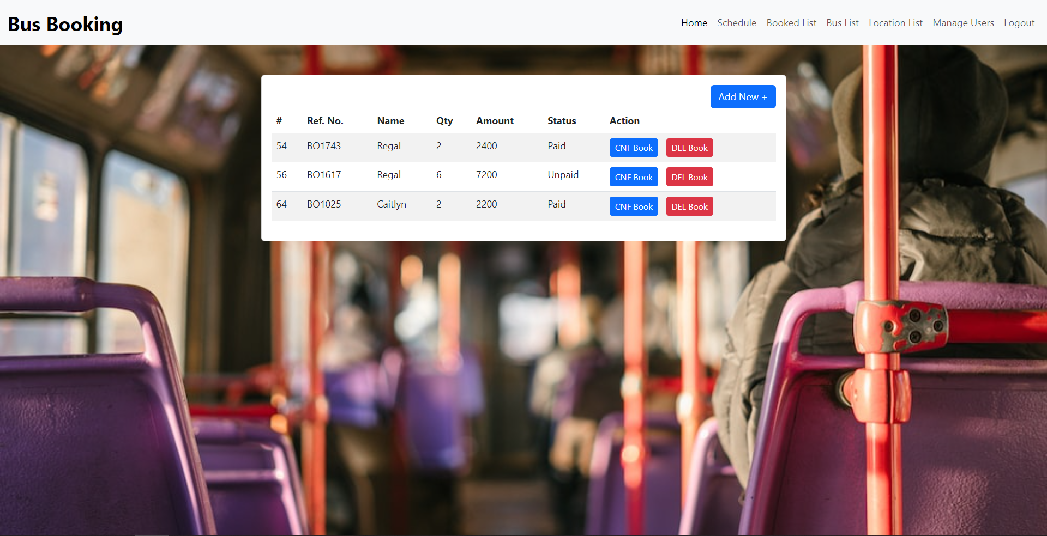
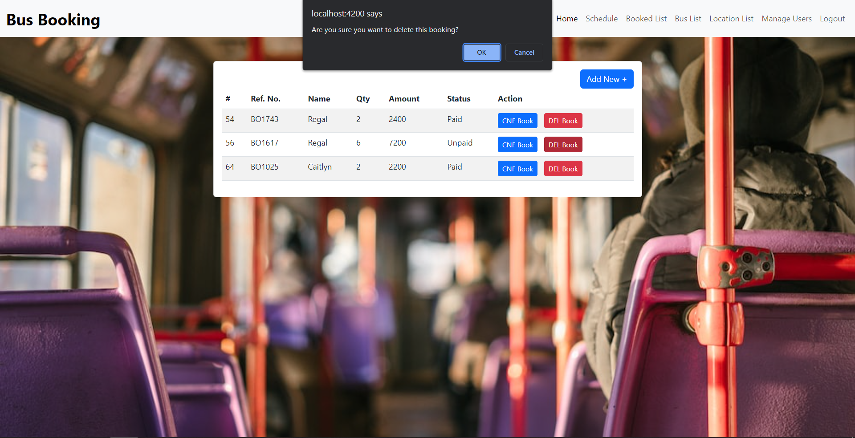
Confirm and Cancel Booking

Slide 27
06
Find Schedule

Slide 28

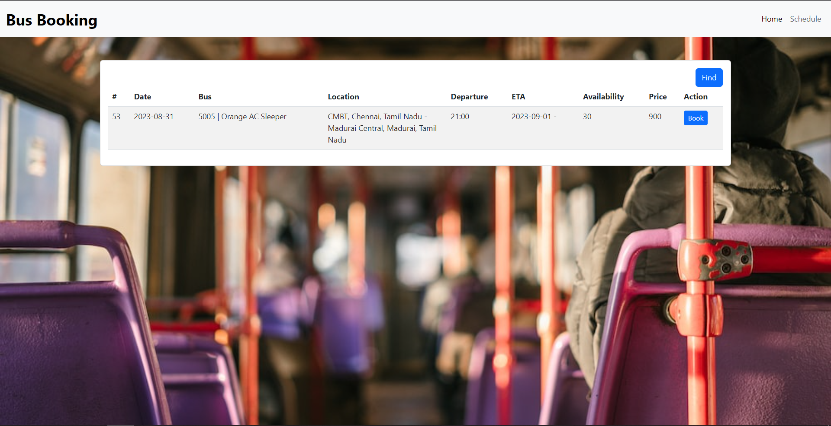
Search for Desired Location

Slide 29

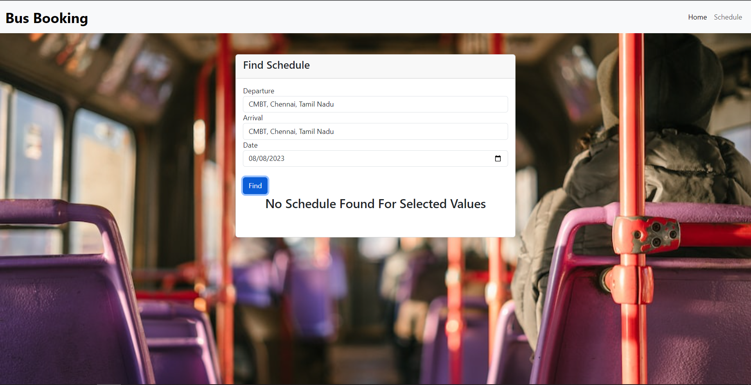
Booking and Invalid Search

Slide 30

Conclusion
The end goal of the project was to create a rich and user-friendly application for Online Bus Booking System which was accomplished
Best Practices were followed and future Scaling of the application is also viable

Slide 31
Thank You!

